Slide 1
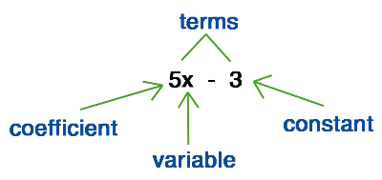
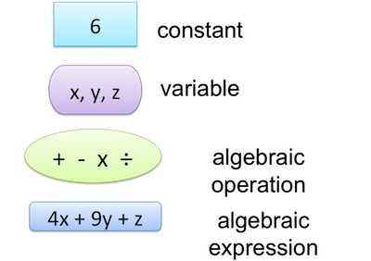
My Algebra Interactive Notebook
Name
Class
Teacher Mr Evans
Term 2 Semester 1
1

Slide 2
Contents
Glossary or Formula Page
Page
Date
Description
2
3

Slide 3
Tasks
24
7
30
Essential Question
Questions
Notes
Summary

Slide 4
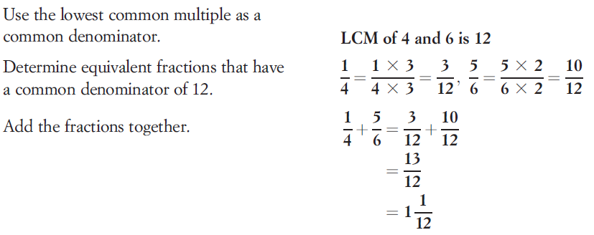
24
7
30
Date
Adding and Subtracting Algebraic Fractions
EQ – What is the difference between adding and subtracting algebraic fractions and normal fractions?
What do I need to do when adding and subtracting fractions?
When adding or subtracting normal numeric fractions we need to ensure we have a lowest common denominator LCD. We do exactly the same when adding or subtracting algebraic fractions.
Example

Slide 5
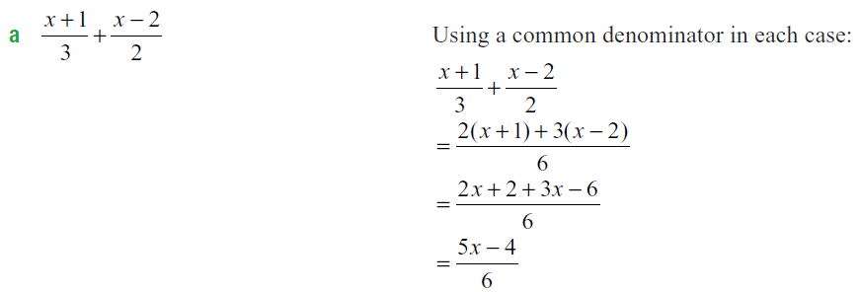
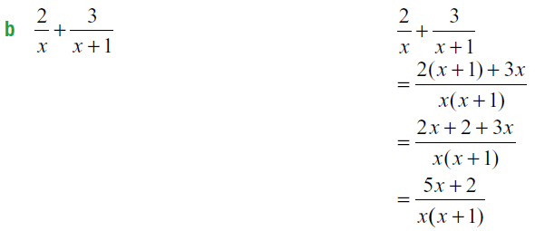
24
7
30
Date
Adding and Subtracting Algebraic Fractions
EQ – What is the difference between adding and subtracting algebraic fractions and normal fractions?
What do I need to do when adding and subtracting algebraic fractions?
We do likewise when adding or subtracting algebraic fractions.
Example

Slide 6
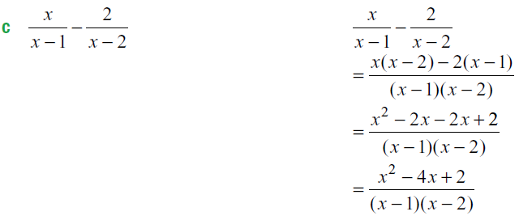
24
7
30
Date
Adding and Subtracting Algebraic Fractions
EQ – What is the difference between adding and subtracting algebraic fractions and normal fractions?
What do I need to do when adding and subtracting algebraic fractions?

Slide 7
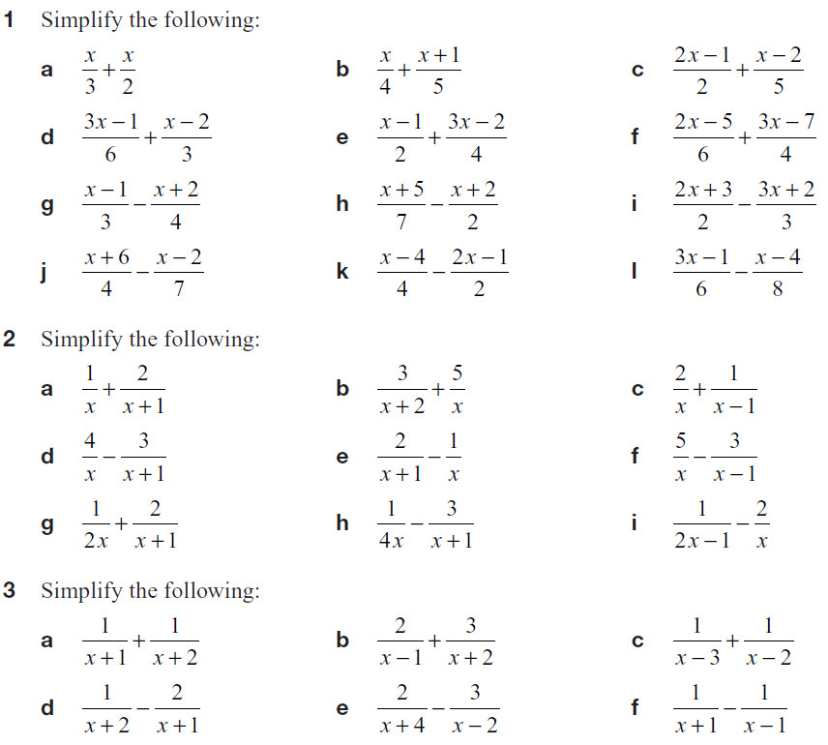
Task

Slide 8
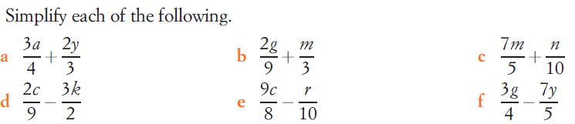
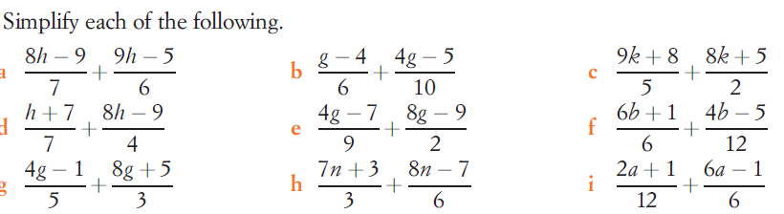
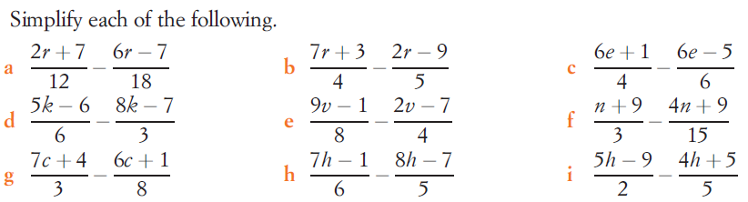
Task

Slide 9
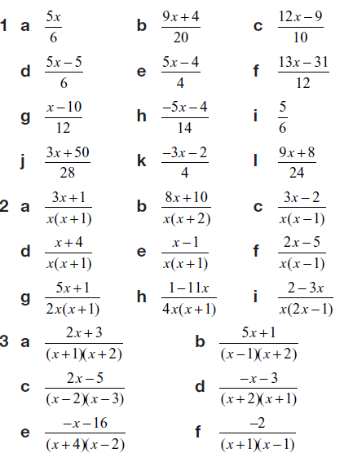
Answers

Slide 10
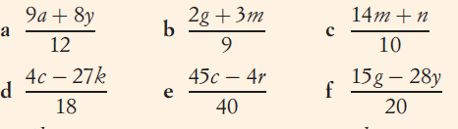
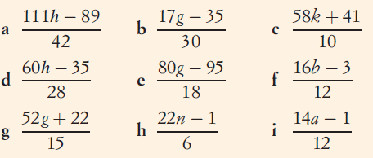
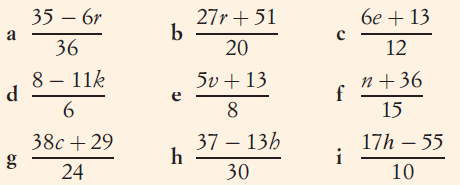
Answers

Slide 11
Notes Review
24, 7 ,30
Date
Title
Essential question
Notes complete
Notes complete with colour and diagrams
Questions completed
Contents page filed in
Formula page filled in

Slide 12
Homework
Review your notes and write a summary answering the essential question.

